Slide 1





LOGISTICS AND DELIVERY APP
PRESENTED BY:
B.MEGHANADH REDDY
R.KOUSHIK SRIRAM

Slide 2


02
Introduction
What is a Logistics Delivery App?
A system used to manage delivery routes efficiently
Used by companies like courier services, food delivery, e-commerce
Real-World Problems:
Finding shortest delivery route
Managing multiple locations
Updating routes dynamically
Handling route failures
Our Solution:
Use Graph Data Structure
Apply Dijkstra Algorithm for shortest path

Slide 3

03
graphical Representation:
Vertices (Nodes): Locations (Cities, Warehouses)
Edges: Routes between locations
Weight: Distance or cost
In Code:
typedef struct Node {
int dest;
int weight;
struct Node* next;
} Node;
Graph Structure:
typedef struct Graph {
int numVertices;
char locations[MAX][50];
Node* adjList[MAX];
} Graph;
Why Adjacency List?
Efficient memory usage
Suitable for sparse graphs
Faster traversal

Slide 4

04
Features of the application:
1. Add Location
Adds new delivery point
Stored in array
2. Add Route
Connects two locations
Assigns distance
3. Display Graph
Shows all routes and connections
4. Search Location
Checks if location exists
5. Update Route
Modify distance between locations
6. Delete Route
Remove existing route
7. Shortest Path
Finds minimum distance using Dijkstra

Slide 5

05
Shortest Path(Dijkstra Algorithm):
Purpose:
Find shortest delivery path between two locations
How it Works:
1.Start from source node
2.Assign distance = 0
3.Update neighboring distances
4.Select minimum distance node
5.Repeat until destination reached
In Code:
dist[s] = 0;
if (dist[u] + temp->weight < dist[temp->dest])
dist[temp->dest] = dist[u] + temp->weight;
Advantages:
Efficient for real-time routing
Helps reduce delivery time and cost

Slide 6



06
System workflow:
Step-by-Step Working:
1.User selects an option (Add Location / Route / Shortest Path)
2.System stores data in Graph (Adjacency List)
3.When route is added → nodes are connected
4.When shortest path is requested:
Dijkstra Algorithm is executed
5.System calculates minimum distance
6.Output is displayed to user
Flow Summary:
Input → Graph Processing → Algorithm → Output
Example:
A → B = 10 km
B → C = 5 km
Shortest path A → C = 15 km

Slide 7
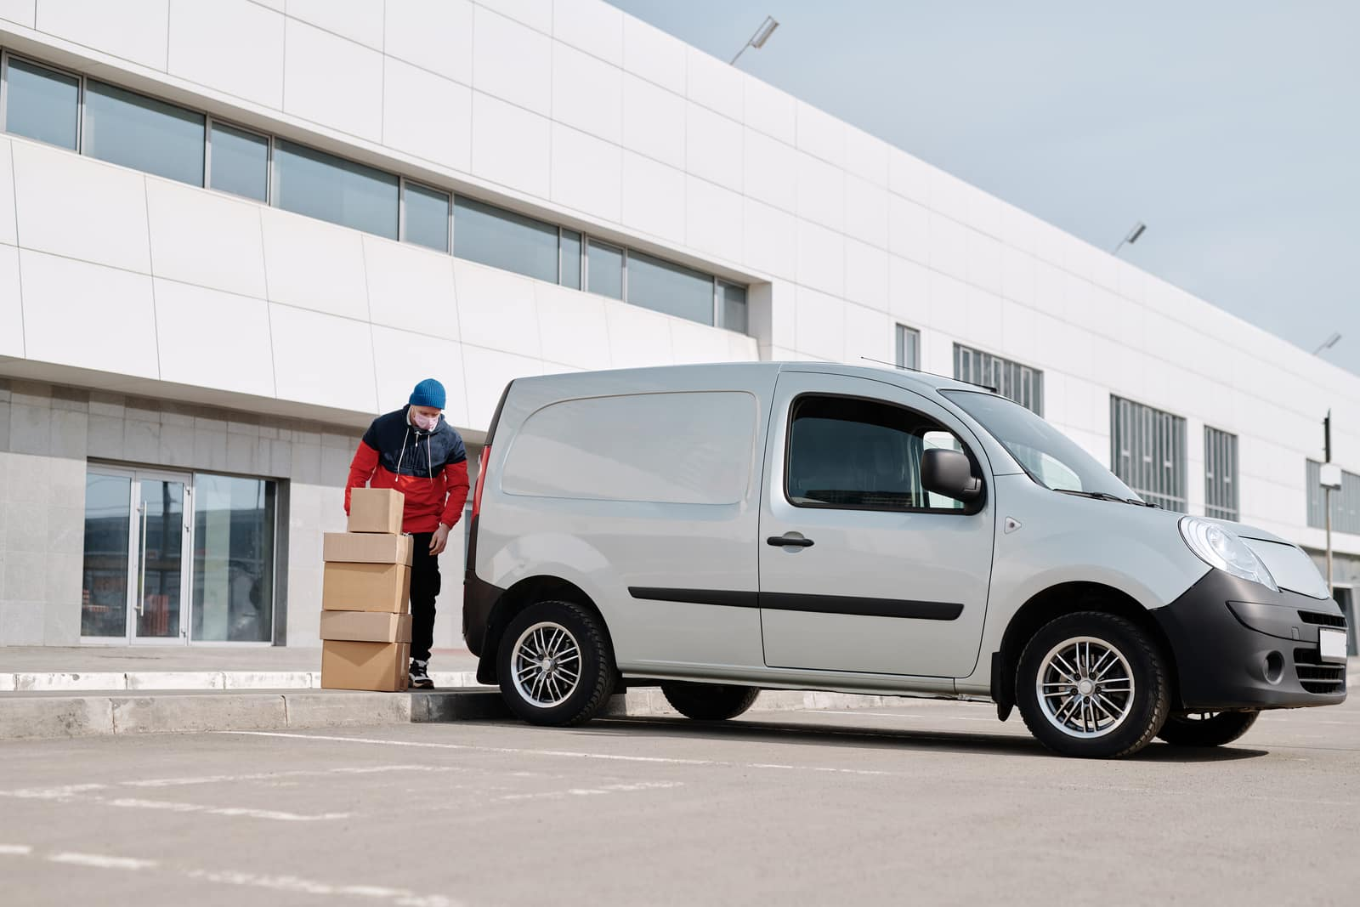
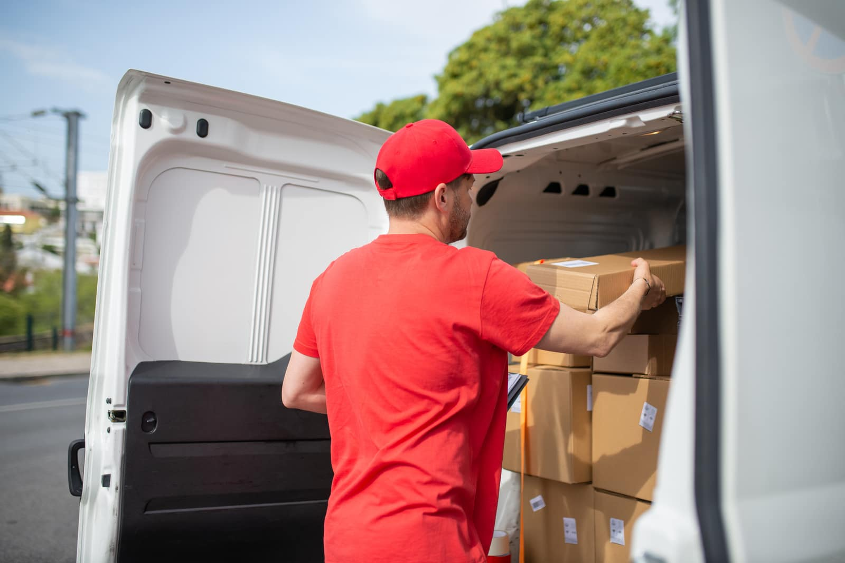
07
Advantages and real-life examples:
Advantages:
1.Fast route calculation
2.Efficient memory usage
3.Handles multiple locations
4.Easy to update routes
Real-Life Example:
Warehouse A
Delivery Point B
Delivery Point C
System finds: 👉 Best route from A → C
👉 Avoids longer paths
Where It Is Used:
1.Amazon delivery systems
2.Swiggy/Zomato routing
3.Google Maps navigation

Slide 8

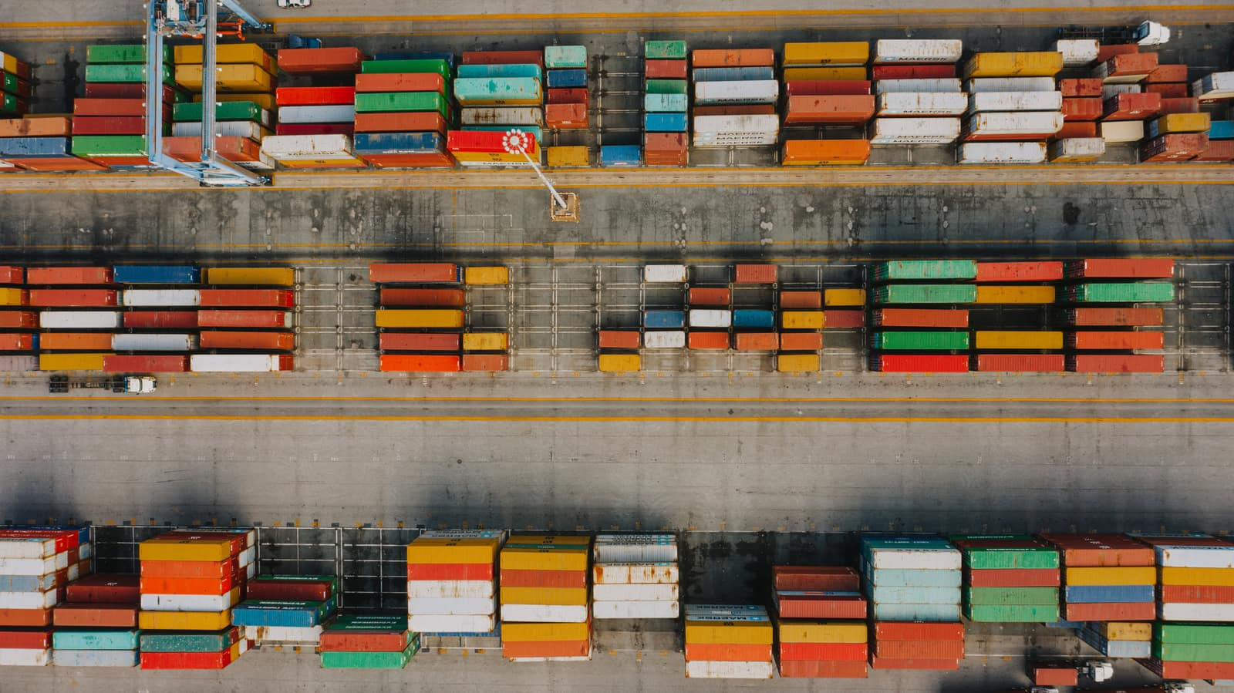
09
Applications and conclusions:
Applications:
Courier delivery systems
Food delivery apps
Ride-sharing apps
Supply chain management
Advantages of This System:
Efficient route management
Dynamic updates
Scalable for large networks
Limitations:
Does not handle traffic conditions
No real-time GPS integration
Future Enhancements:
Add GPS tracking
Real-time traffic updates
Mobile app integration
Use advanced algorithms (A*, AI-based routing)

Slide 9
THANK YOU

